Slide 2
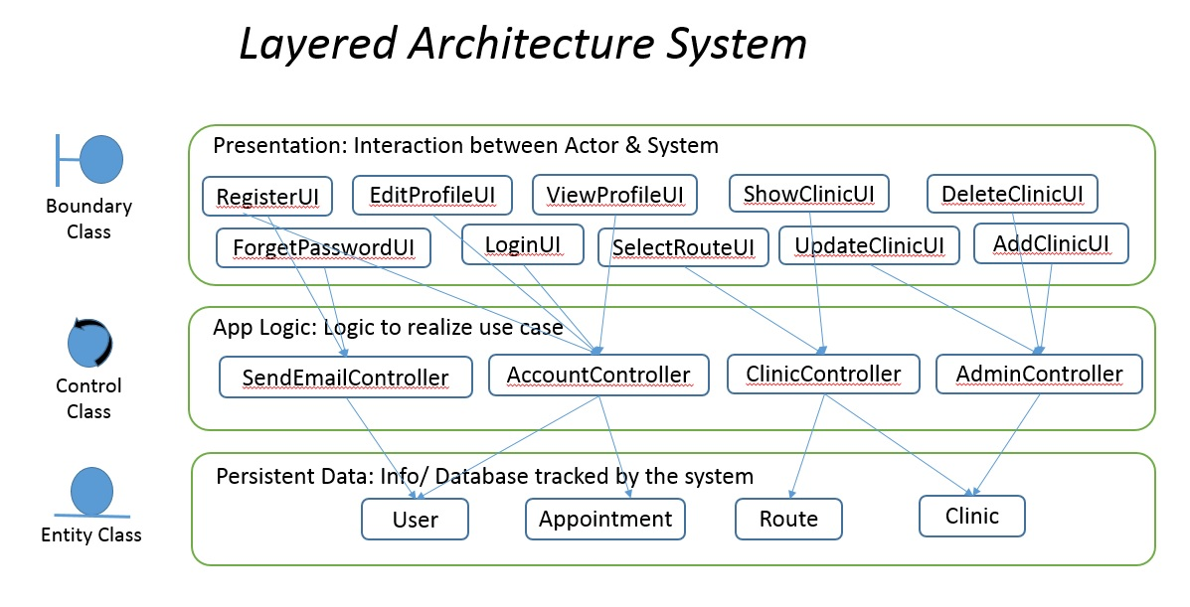
System Architecture

Slide 3
Presentation: Interaction between Actor & System
Student Account View
Search Nearby Counsellor View
Journal Comment Form View
Assigned Student List View
Share Student View
Action View
Treatment Log View
Journal Entry View
Counsellor Account View
Student View
Account Access View
Boundary Class
Create Treatment Log View
Shared Student List View
Form View
Create Journal View
Module Assignment View
Student Assignment View
Set Grade View
Admin Assignment View
Module Assignment Controller
Counsellor Controller
Student Controller
Account Access Control
Student Assignment Controller
Journal Controller
Control Class
Treatment Log Controller
App Logic : Logic to realize use case
Treatment Log
Counsellor
Student
Journal Entry
Module
User
Grade Report
Entity Class
Persistent Data : Info / Database tracked by the system

